Slide 1
PRESENTATION OBJECT ORIENTED PROGRAMMING
Name: MALAIKA ZAHOOR Submitted to:
Sir Adeel khalid

Slide 2
Object-Oriented Programming (OOP) in Library Management System
Built with Java (Frontend) + Oracle (Backend)
Eclipse IDE
Key OOP Concepts Applied

Slide 3
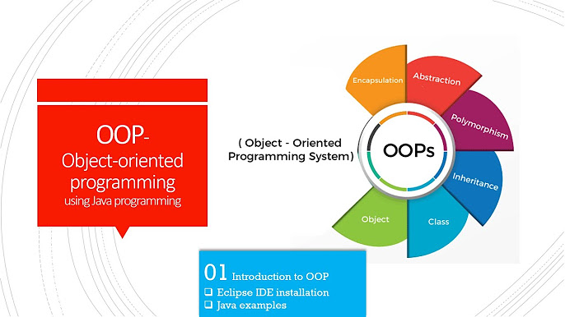
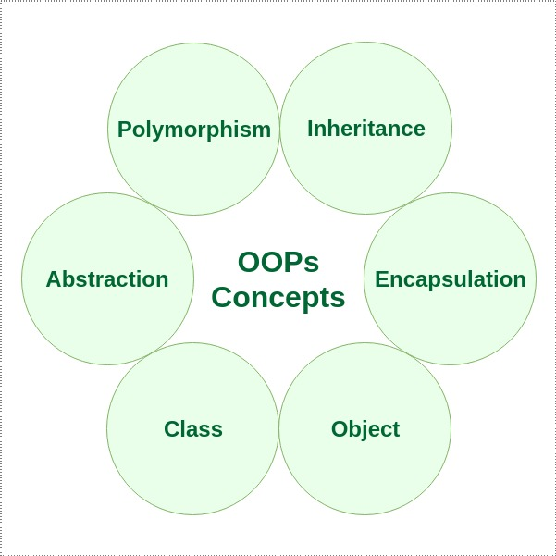

Slide 4
Key Points:
What is OOP?
Paradigm based on "objects" (data + methods).
Why OOP for LMS?
Modularity (e.g., Book, User, Transaction classes).
Reusability (inheritance for Staff/Student roles).
Encapsulation (secure data like passwords).

Slide 5
OOP Pillars in LMS
Four Pillars with Examples:
Encapsulation
Private fields (e.g., User.password) + public getters/setters.
Inheritance
User → Librarian and Member classes.
Polymorphism
Overriding calculateFine() for different user types.
Abstraction
Abstract class DatabaseConnector for Oracle DB operations.

Slide 6
Class Diagram (UML)
Visualize
Classes: Book, User, Transaction, DatabaseManager.
Relationships:
Composition: Library has Books.
Inheritance: User → Librarian.
Code Snippet:
java
Copy
Download
public abstract class User { private String username; // Encapsulation public abstract void login(); // Abstraction }

Slide 7
Key Java Classes in LMS
Book.java
Properties: bookId, title, author.
User.java (Abstract)
Subclasses: Librarian.java, Member.java.
DatabaseConnector.java
Singleton pattern for Oracle DB connection.
Example:
java
Copy
Download
public class DatabaseConnector { private static Connection conn; // Singleton public static Connection getConnection() { if (conn == null) { conn = DriverManager.getConnection(/* Oracle URL */);

Slide 8
Polymorphism in Action
Scenario: Fine calculation differs for Member vs Guest.
java
Copy
Download
// In Member.java @Override public double calculateFine() { return daysOverdue * 0.50; // Rs 0.50/day } // In Guest.java @Override public double calculateFine() { return daysOverdue * 1.00; // Rs 1.00/day }

